Slide 1
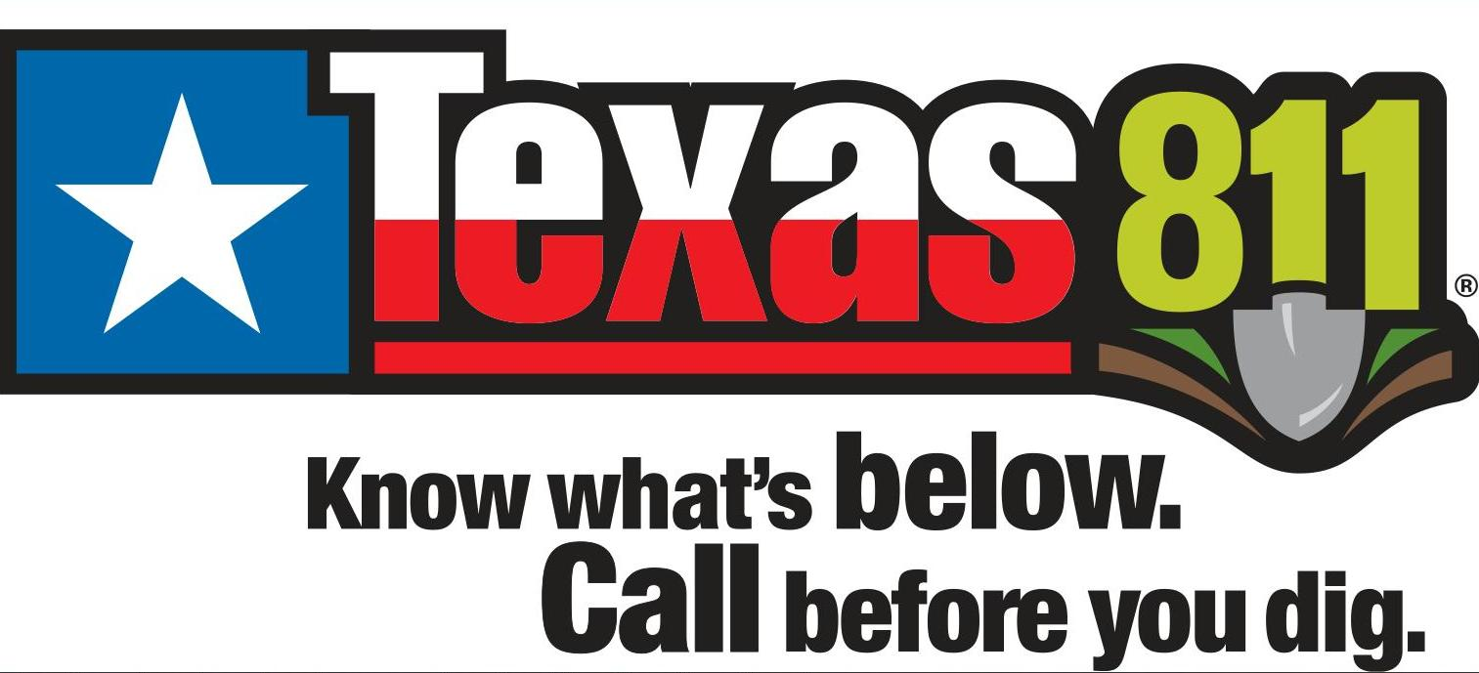
Calling a one call ticket & excavator responsibilities
THINGS YOU NEED TO KNOW.

Slide 2
TYPES OF ONE CALL TICKETS
NORMAL NEW
TICKET TYPE WITH AT LEAST 2 BUSINESS DAY NOTICE AND NO MORE THEN 14 DAYS VALID
UPDATE & REMARK
TO EXTEND THE LIFE OF THE TICKET TO STAY COMPLIANT OR TO HAVE THE UTILITIES REMARKED & REFRESHED
NON-COMPLIANT
TICKET TYPE WITH LESS THAN 2 BUSINESS DAY NOTICE. THIS LETS THE EXCAVATOR DETERMINE THE TIME AND DATE OF WORK. HOWERVER THE EXCAVATOR TAKES FULL RESPOSIBILITY OF ALL DAMAGES TO UNMARKED LINES
SURVEY & DESIGN
TICKET USED WHEN NO EXCAVATION IS TAKING PLACE. BUT ALLOWS THE EXCAVATOR TO SEE THE UTILITIES FOR DESIGNING AN UPCOMING POROJECT.
EMERGENCY / DIG UP
TICKET TYPE IS USED WHEN AN EXCAVATION OPERATION IS NEEDED BECAUSE IF THE WORK IS NOT DONE IT COULD RESULT IN DANGERING LIFE, HEALTH, AND PROPERTY OR WHEN AN EXCAVATION RESULTED IN AN EXSPOSURE OR DAMAGE TO AN UNDERGROUND UTILITY.

Slide 3
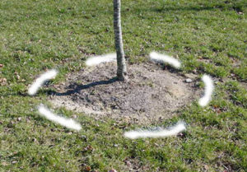
STEPS FOR CALLING IN A ONE CALL TICKET
DETERMINE THE WORK AREA & EXCAVATION TYPE
1
WHITE LINE OR MARK THE REQUESTED DIG AREA
2
MAP OUT THE DRIVING DIRECTIONS & GPS COORDINATES OF WHERE THE WORK IS TAKING PLACE
3
CALL 811 OR SUBMIT ON THE 811 PORTAL
4
WAIT 2 BUSINESS DAYS FOR ALL UTILITY OWNERS TO RESPOND
5
SUBMIT A “NO RESPONSE” IF UTILITY OWNERS HAVE NOT RESPONDED WITHIN THE TWO BUSINESS DAYS
6

Slide 4
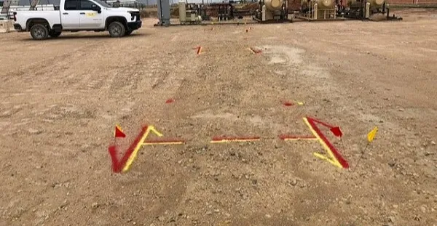
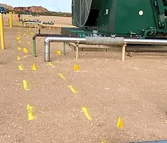
CONFIRM THE MARKINGS
CONFIRM THAT ALL UTILITY OWNERS ON THE ONE CALL TICKET HAS RESPONDED
MARKINGS CAN BE VERIFIED BY COMPARING THE MARKINGS ON THE GROUND WITH THE RESPONSES THAT YOU RECEIVED FROM THE UTILITY OWNERS
LEARN WHAT EACH COLOR MARKING REPRESENTS
IF THERE IS MARKED LINES IN THE WORK AREA, CALL THE UTILITY OWNERS AND ASK FOR THEIR LINE CROSSING PROCEDURES AND STANDARDS

Slide 5
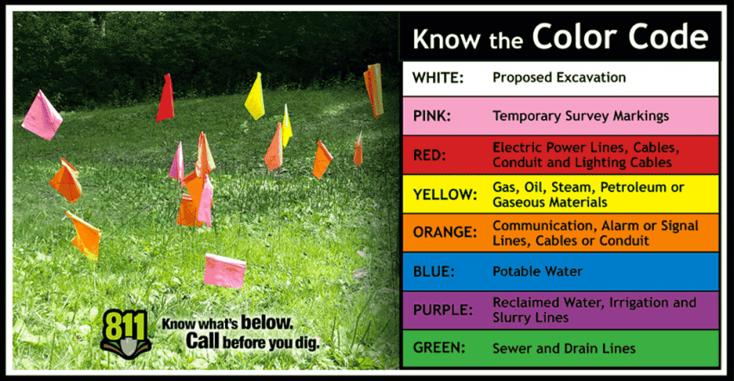
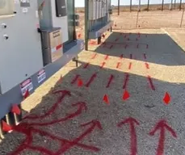
EXCAVATION DAY
BEFORE ANY EXCAVATION IS STARTED WALK THE SITE TO VERIFY ALL MARKED LINES IN THE AREA
LOOK AROUND FOR ANY UNKNOWN AND UNMARKED LINES
LOOK FOR HARD MARKERS, VENT RISERS, GROUND SCARRING, OLD MARKINGS.
RESPECT AND REPLACE THE MARKINGS PROVIDED BY THE UTILITY COMNPANY. THESE MARKINGS ARE YOUR GUIDE FOR THE DURATION OF THE PROJECT
IT IS THE RESPONSIBILITY OF THE PERSON DIGGING TO AVOID HITTING MARKED LINES
CALL 811 FOR AN UPDATE REMARK IF MARKINGS ARE NO LONGER VISIBLE

Slide 6
IMPORTANT THINGS TO KNOW
LOCATE TICKETS ARE VALID FOR 14 BUSINESS DAYS, EXCLUDING WEEKENDS AND HOLIDAYS
THE DAY YOU CALL THE TICKET IN IS DAY 1 OF THE 14 DAYS
UPDATE YOUR TICKET NO LATER THEN DAY12 TO STAY ACTIVE OR WHEN THE MARKINGS ARE NO LONGER VISIBLE
DO NOT DIG WITHIN THE TOLERANCE ZONE WHICH IS 18” ON EACH SIDE OF THE MARKED LINE, PLUS THE DIAMETER OF THE LINE
ALWAYS VERIFY DEPTH AND DIRECTION PRIOR TO DIGGING AROUND BURIED UTILITIES
REFER TO CHAPTER 251UNDERGROUND PREVENTION SAFETY ACT & CHAPTER 18 TEXAS ADMINISTRACTIVE CODE PER RAILROAD COMMISION

Slide 7
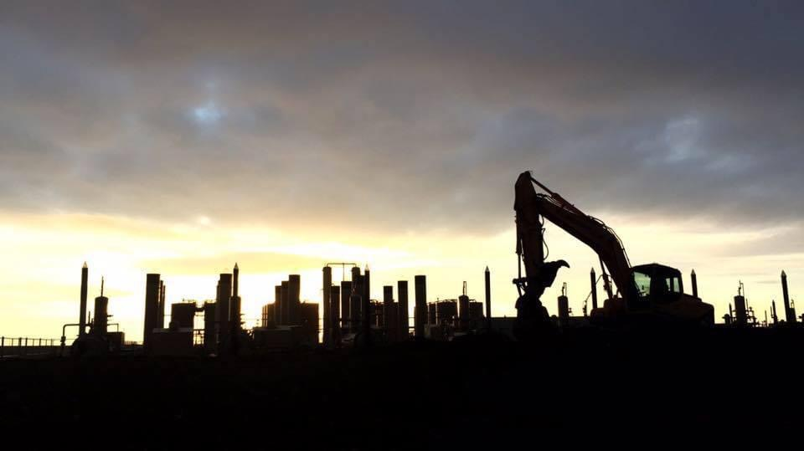
IMPORTANT THINGS TO KNOW
A COPY OF THE ONE CALL TICKET IS REQUIRED TO BE ON SITE WITH THE EXCAVATOR
ALL LINE STRIKES SHOULD BE REPORTED TO THE RRC WITHIN 10 DAYS OF THE INCIDENT, AND AN EMERGENCY ONE CALL SHOULD BE MADE
EVERY EXCAVATOR IS REQUIRED TO HAVE THEIR OWN ONE CALL TICKET. NO PIGGY BACKING IS ALLOWED

Slide 8
Pioneer line crossing procedures
THERE IS NO MECHANICAL EXCAVATION ALLOWED WITHIN 25 FT OF PIONEER LINES AND ASSETS
EXCAVATOR MUST CALL T&M LINE CROSSING REP 48 HRS IN ADVANCE TO SET UP LINE CROSSINGS & ON-SITE MEETING
EXCAVATOR MUST VERIFY LINES FOR DEPTH AND DIRECTION 3’X3’X3’
NO DIGGING WITHIN THE TOLERANCE ZONE OF THE LINES AT ALL
LINE CROSSING REP DOES NOT NEED TO BE PRESENT FOR HYDRO EXCAVATION.
LINE CROSSING REP WILL NEED TO BE PRESENT FOR DIG OUT, CROSSING, AND BACKFILL
IF ADITIONAL HELP AND VERIFICATION IS NEEDED A PIONEER REP WILL BE NOTIFIED

Slide 9
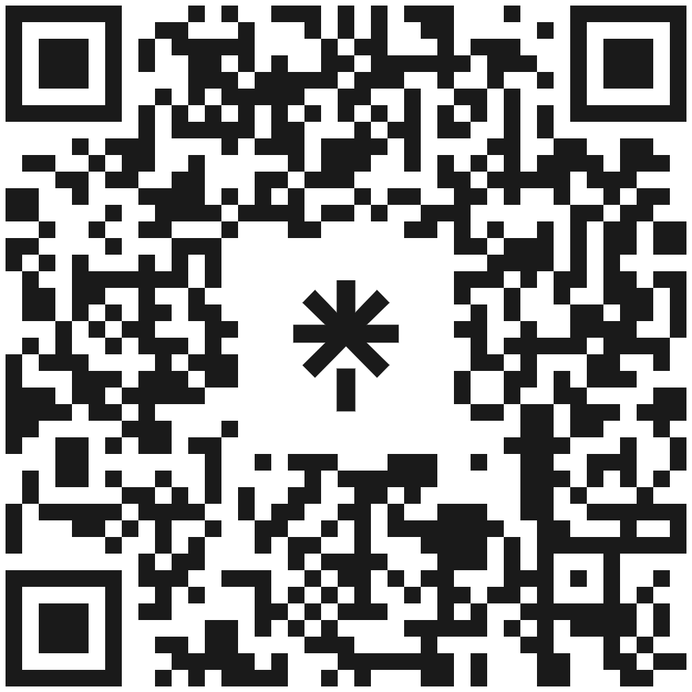
CONTACT US!

